Slide 1
s
Theme:
The problems of unemployment

Slide 2
Unemployment - a phenomenon that is organically linked with the labor mark.According to the International Labour Organization - unemployed recognized anyone who does not currently have a job, looking for work and ready to start working.
Considered unemployed able-bodied citizens who are out of work and earnings, registered with employment agencies to find suitable work, looking for work and ready to start
Official unemployed are able-bodied citizens of working age (defined by legislation), residing in the territory of the State, no employment, no entrepreneurial activity, not enrolled in full-time education or not passing military service and registered at the labor exchange (in public service employment).

Slide 3
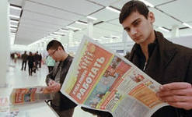

Slide 4
The category of «non-labour force» include people who are not engaged in social work and not seeking work. This category automatically includes the following groups: children under 16 years of age, persons serving a prison sentence, people in psychiatric hospitals and the disabled.In addition, the categories are not included in the labor force are the people who could potentially work, but do not do so for various reasons, ie who do not want or can not work and are not looking for work: full-time students (as the need to learn), retired (as already fulfilled its) Housewives (because while working full-time, but not in social production and are not paid for their work) tramp (because do not want to work), people that have stopped looking for work (looking for work, but desperate to find it and therefore eliminated from the labor force).

Slide 6
The category «labour force» include people who can work, want to work and actively looking for work. They are people who are either already engaged in social production, or do not have jobs, but make special efforts to find her. Thus, the total labor force is divided into two parts:
employed (employed - E) - ie with a job, and no matter busy people full-time or part-time, full-time or part-time. A person is also considered employment-empty if it does not work for the following reasons: a) is on leave, and b) is ill, c) is on strike and d) due to bad weather;
unemployed (unemployed - U) - ie not having a job, but it is actively seeking. Job search is the main criterion that distinguishes the unemployed from people who are not included in the labor force. Thus, the total labor force is: L = E + U.

Slide 7
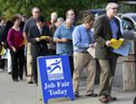

Slide 8
Types of unemployment
Frictional unemployment (from the word "friction" - friction) associated with job search.Obviously, the job requires time and effort, so people waiting or looking for work, some time is unemployed status. The man lost his job today, can not usually find another job tomorrow
By friction are unemployed:
dismissed from work on the orders of the administration;
resigned;
expected recovery in the previous work;
have found a job, but have not started it;
Seasonal workers (not in season);

Slide 9
Partial unemploiment
One kind of partial unemployment is unemployment, which is the result of lower demand for the company's products. In this case, there are two options trader behavior: either it retains the ability of the staff to work full-time and one part of the fires, with or without discharge allows you to work part-time, all that leads to partial unemployment.

Slide 10
Seasonal unemployment
Seasonal unemployment, which is generated by the temporary nature of the implementation of various activities and functioning of economic sectors.These include agricultural work, fishing, berry picking, timber rafting, hunting, some construction and some other activities. This type of unemployment on individual characteristics corresponds cyclical unemployment, on the other - the friction, because it is voluntary

Slide 12
Long-term unemployment
Another type of unemployment - long-term unemployment. She describes that part of the population that is constantly deprived of work or odd jobs.This part of the people who lost their lawful means, as a rule, join the ranks of the underworld.Based on the need to address unemployment and to take appropriate measures to ensure the public work of all comers, are distinguished: Registered unemployment rate, which reflects the number of unemployed job seekers who are ready to start working and take stock of the state employment service, hidden unemployment, which includes workers engaged in the production, but in reality are "superfluous.ule, join the ranks of the underworld.

Slide 13
If a person is given the freedom of choice of occupation and place of work, at any given moment, the part of employees is in a position where they have already left the old job, but have not yet arrived at a new.Some of them change jobs voluntarily, others - for the first time looking for a job, and others - have completed seasonal work.Part of the people looking for a suitable job, employ, others - to temporarily leave the work, but, in general, this type of unemployment remains.Rising unemployment in Kazakhstan is seen as a consequence of the global financial crisis. With this statement we can agree, but only partially.

Slide 14
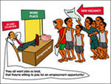

Slide 15
The unemployment rate in Kazakhstan was last reported at 5.2 percent in the third quarter of 2012. Historically, from 2003 until 2012, Kazakhstan Unemployment Rate averaged 7.0 Percent reaching an all time high of 9.7 Percent in March of 2003 and a record low of 5.2 Percent in September of 2012. The unemployment rate can be defined as the number of people actively looking for a job as a percentage of the labour force. This page includes a chart with historical data for Kazakhstan Unemployment Rate.
Kazakhstan Unemployment Rate

Slide 16
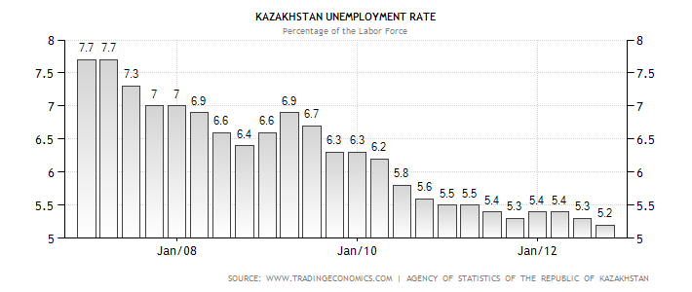

Slide 17
As President, N.A Nazarbayev said at the presentation of his new strategy to bring the country out of the crisis "Kazakhstan-2030" - "... we (the government) can not implement all the reforms without the necessary support of the people of the republic, as it is the people of Kazakhstan the only one who can lift the country out of crisis.You can not always hope that there will be a foreign businessman, will invest millions of dollars into the country, and live better. This will not happen. "And I think that not only do I agree with this statements.

Slide 18
Solutions to the problem of unemployment
To exit from the crisis and the rise of production must be an active part of the state.Our organizations and enterprises now strangling huge taxes, which is why, and increase the cost of production - forcing companies to cut its staff.The lack of scientific and technological achievements can be solved by active funding for scientific research and support entrepreneurs, reduce taxes on private business.Then, at their expense can increase GDP, and the share of the shadow economy will decline sharply.

